Slide 1
Fundamentals
Assembly Code
Yan Shoshitaishvili
Arizona State University

Slide 2
Reminder: Computer Architecture
CPU
Memory
L2
Cache
Registers
CU
Disk
L1 Cache
ALU
"Some sort of bridge."
Registers
CU
Network + Others
L1 Cache
ALU

Slide 3
Assembly
The only true programming language, as far as a CPU is concerned.
Concepts:
instructions
data manipulation instructions
comparison instructions
control flow instructions
system calls
registers
memory
program
stack
other mapped mem

Slide 4
Registers
Registers are very fast, temporary stores for data.
You get several "general purpose" registers:
8085: a, c, d, b, e, h, l
8086: ax, cx, dx, bx, sp, bp, si, di
x86: eax, ecx, edx, ebx, esp, ebp, esi, edi
amd64: rax, rcx, rdx, rbx, rsp, rbp, rsi, rdi, r8, r9, r10, r11, r12, r13, r14, r15
arm: r0, r1, r2, r3, r4, r5, r6, r7, r8, r9, r10, r11, r12, r13, r14
The address of the next instruction is in a register:
eip (x86), rip (amd64), r15 (arm)
Various extensions add other registers (x87, MMX, SSE, etc).

Slide 5
Partial Register Access
rax
eax
ax
ah
al
Registers can be accessed partially.
Due to a historical oddity, accessing eax will zero out the rest of rax. Other partial access preserve untouched parts of the register.

Slide 6
All partial accesses on amd64 (that I know of)
64 32 16 8H 8L
rax eax ax ah al
rcx ecx cx ch cl
rdx edx dx dh dl
rbx ebx bx bh bl
rsp esp sp spl
rbp ebp bp bpl
rsi esi si sil
rdi edi di dil
r8 r8d r8w r8b
r9 r9d r9w r9b
r10 r10d r10w r10b
r11 r11d r11w r11b
r12 r12d r12w r12b
r13 r13d r13w r13b
r14 r14d r14w r14b
r15 r15d r15w r15b

Slide 7
Instructions
General form:
OPCODE OPERAND OPERAND, ...
OPCODE - what to do
OPERANDS - what to do it on/with
mov rax, rbx
add rax, 1
cmp rax, rbx
jb some_location
Useful reference: http://ref.x86asm.net

Slide 8
Instructions (data manipulation)
Instructions can move and manipulate data in registers and memory.
mov rax, rbx
mov rax, [rbx+4]
add rax, rbx
mul rsi
inc rax
inc [rax]

Slide 9
Instructions (control flow)
Control flow is determined by conditional and unconditional jumps.
Unconditional: call, jmp, ret
Conditional:
je jne jg jl jle jge ja jb jae jbe js jns jo jno jz jnz | jump if equal jump if not equal jump if greater jump if less jump if less than or equal jump if greater than or equal jump if above (unsigned) jump if below (unsigned) jump if above or equal (unsigned) jump if below or equal (unsigned) jump if signed jump if not signed jump if overflow jump if not overflow jump if zero jump if not zero
cmp rax, rbx
jb some_location 🤔

Slide 10
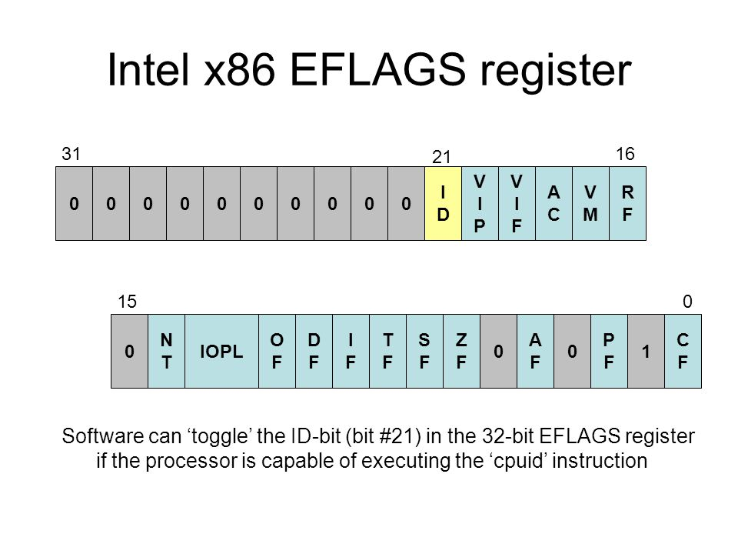
Instructions (conditionals)
je jne jg jl jle jge ja jb jae jbe js jns jo jno jz jnz | jump if equal jump if not equal jump if greater jump if less jump if less than or equal jump if greater than or equal jump if above (unsigned) jump if below (unsigned) jump if above or equal (unsigned) jump if below or equal (unsigned) jump if signed jump if not signed jump if overflow jump if not overflow jump if zero jump if not zero | ZF=1 ZF=0 ZF=0 and SF=OF SF!=OF ZF=1 or SF!=OF SF=OF CF=0 and ZF=0 CF=1 CF=0 CF=1 or ZF=1 SF=1 SF=0 OF=1 OF=0 ZF=1 ZF=0
Conditionals key off of the "flags" register:
eflags (x86), rflags (amd64), aspr (arm).
Updated by (x86/amd64):
arithmetic operations
cmp - subtraction (cmp rax, rbx)
test - and (test rax, rax)

Slide 11
Instructions (system calls)
Almost all programs have to interact with the outside world!
This is primarily done via system calls (man syscalls). Each system call is well-documented in section 2 of the man pages (i.e., man 2 open).
System calls (on amd64) are triggered by:
set rax to the system call number
store arguments in rdi, rsi, etc (more on this later)
call the syscall instruction
We can trace process system calls using strace.

Slide 12
System Calls
System calls have very well-defined interfaces that very rarely change.
There are over 300 system calls in Linux. Here are some examples:
int open(const char *pathname, int flags) - returns a file new file descriptor of the open file (also shows up in /proc/self/fd!)
ssize_t read(int fd, void *buf, size_t count) - reads data from the file descriptor
ssize_t write(int fd, void *buf, size_t count) - writes data to the file descriptor
pid_t fork() - forks off an identical child process. Returns 0 if you're the child and the PID of the child if you're the parent.
int execve(const char *filename, char **argv, char **envp) - replaces your process.
pid_t wait(int *wstatus) - wait child termination, return its PID, write its status into *wstatus.
Typical signal combinations:
fork, execve, wait (think: a shell)
open, read, write (cat)
Critical resource: https://blog.rchapman.org/posts/Linux_System_Call_Table_for_x86_64/

Slide 13
Memory (stack)
The stack fulfils four main uses:
Track the "callstack" of a program.
return values are "pushed" to the stack during a call and "popped" during a ret
Contain local variables of functions.
Provide scratch space (to alleviate register exhaustion).
Pass function arguments (always on x86, only for functions with "many" arguments on other architectures).
Relevant registers (amd64): rsp, rbp
Relevant instructions (amd64): push, pop

Slide 14
Memory (other mapped regions)
Other regions might be mapped in memory. We previously talked about regions loaded due to directives in the ELF headers, but functionality such as mmap and malloc can cause other regions to be mapped as well.
These will feature prominently (and be discussed) in future modules.

Slide 15
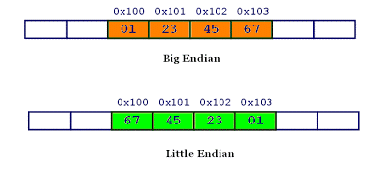
Memory (endianess)
Data on most modern systems is stored backwards, in little endian.
Why?
Performance (historical)
Ease of addressing for different sizes.
(apocryphal) 8086 compatibility

Slide 16
Signedness: Two's Compliment
How to differentiate between positive and negative numbers?
One idea: signed bit (8-bit example):
b00000011 == 3
b10000011 == -3
drawback 1: b00000000 == 0 == b10000000
drawback 2: arithmetic operations have to be signedness-aware
(unsigned) b11111111 + 1 == 255 + 1 == 0 == b00000000 (signed) b11111111 + 1 == -127 + 1 == -126 == b11111110
Clever (but crazy) approach: two's complement
b00000000 == 0
0 - 1 == b11111111 == 0xff == -1
-1 - 1 == b11111110 == 0xfe == -2
advantage: arithmetic operations don't have to be sign-aware! (unsigned) b11111111 + 1 == 255 + 1 == 0 == b00000000 (signed) b11111111 + 1 == -1 + 1 == 0 == b00000000
disadvantage: you might go crazy
As a benefit of two's complement, signedness mostly crops up in conditional checks.

Slide 17
Calling Conventions
Callee and caller functions must agree on argument passing.
Linux x86: push arguments (in reverse order), then call (which pushes return address), return value in eax
Linux amd64: rdi, rsi, rdx, rcx, r8, r9, return value in rax
Linux arm: r0, r1, r2, r3, return value in r0
Registers are shared between functions, so calling conventions should agree on what registers are protected.
Linux amd64: rbx, rbp, r12, r13, r14, r15 are "callee-saved"

Slide 18
Other Resources
Rappel (https://github.com/yrp604/rappel) lets you explore the effects of instructions.
easily installable via https://github.com/zardus/ctf-tools
Opcode listing: http://ref.x86asm.net/coder64.html
x86_64 architecture manual: https://www.intel.com/content/dam/www/public/us/en/documents/manuals/64-ia-32-architectures-software-developer-instruction-set-reference-manual-325383.pdf

